Slide 1
The European Digital CH Conservator
It studies, makes assessments and proposes solutions to preserve cultural heritage (CH)

Slide 2
Project Facts
EC Funded project
Funding from the European Union’s Horizon 2020 research and innovation programme under grant agreement no 821054
Duration: 4 years (June 2019 – November 2022)
18 partners from 8 EU countries;
Coordinator: Dr. Angelos Amditis, Institute of Communication & Computer Systems

Slide 3
THE CHALLENGES

Slide 4
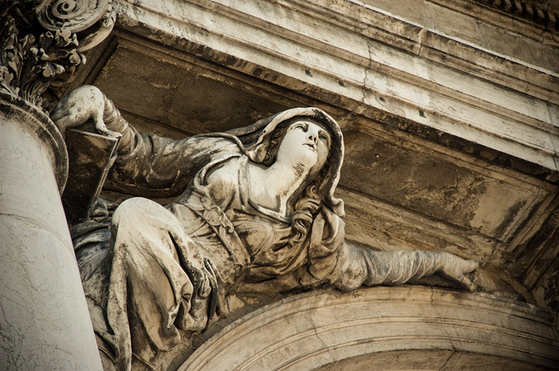
The problem
Climate Change (CC), ravages of time, intense geological phenomena & accidental, extreme weather conditions has a significant impact on historical areas hosting Cultural Heritage (CH) sites.

Slide 5
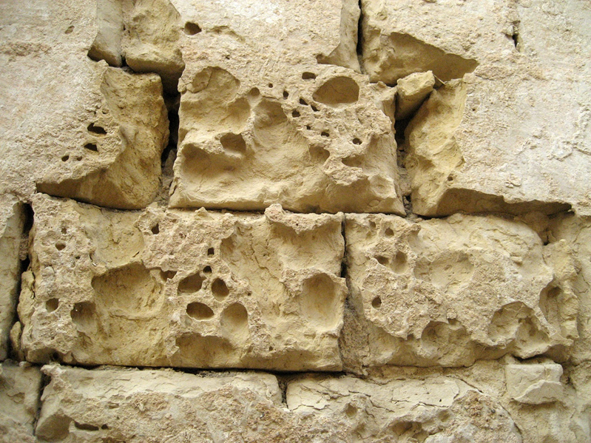
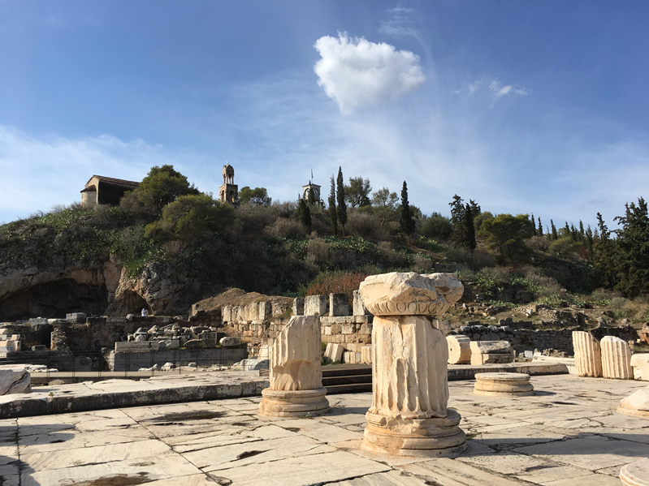
Current challenges
The deterioration of CH sites is one of the biggest challenges in conservation; Aspects such as building technologies/materials, structural responses, preventive measures and restoration strategies, resilience and adaptation methodologies must be considered;
Difficulty to assess quantitatively and qualitatively the impact of various climatic & other parameters on the CH sites;
Limited strategies on CC-related issues;
Absence of an overall resilience & reconstruction planning framework for historic areas.

Slide 6
THE CONCEPT

Slide 7
HYPERION main objectives
HYPERION will provide its end users with the appropriate tools that will help them:
Understand better the effects of climate change, ravages of time, intense geological phenomena & accidental, extreme weather conditions on archaeological sites and cultural heritage monuments;
properly adapt their policies and activities towards deploying sustainable mitigation plans & providing efficient reconstruction of the cultural heritage parts that have been damaged.

Slide 8
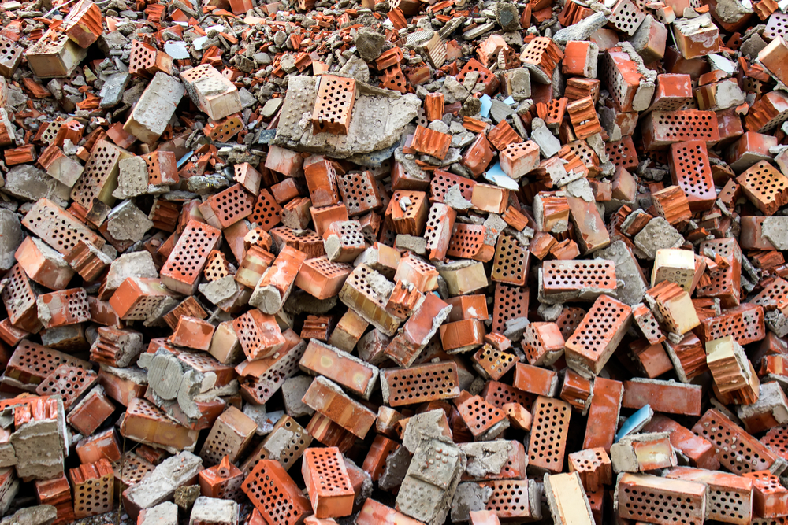
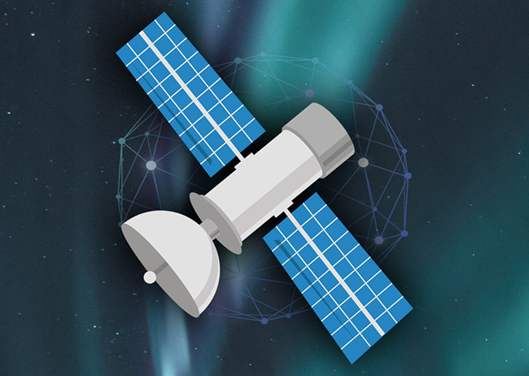
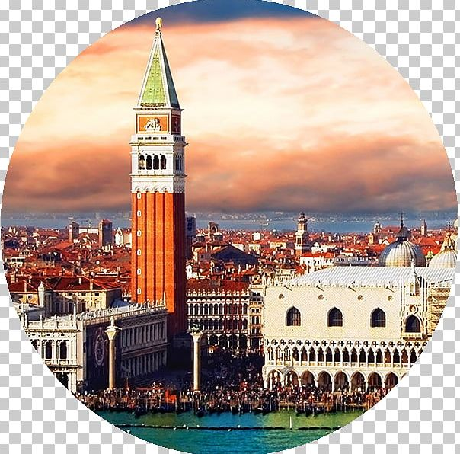
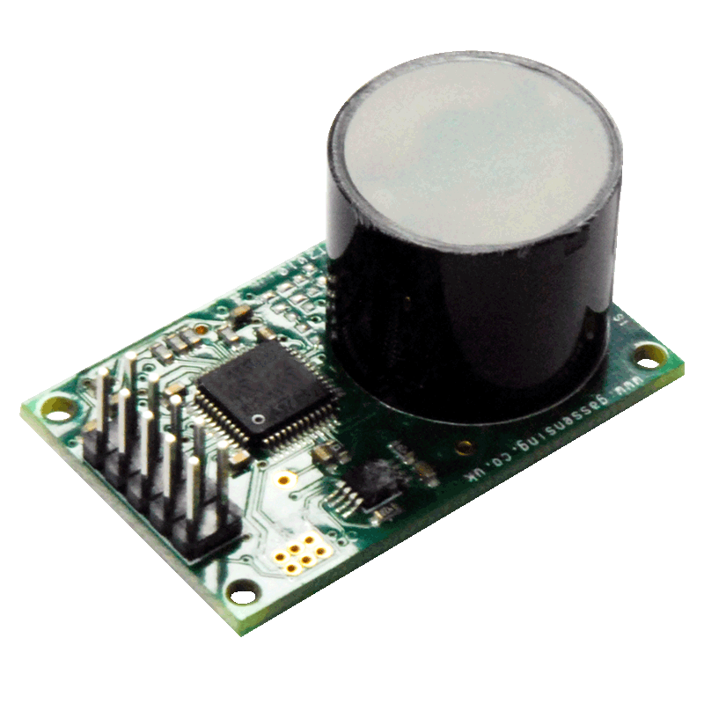
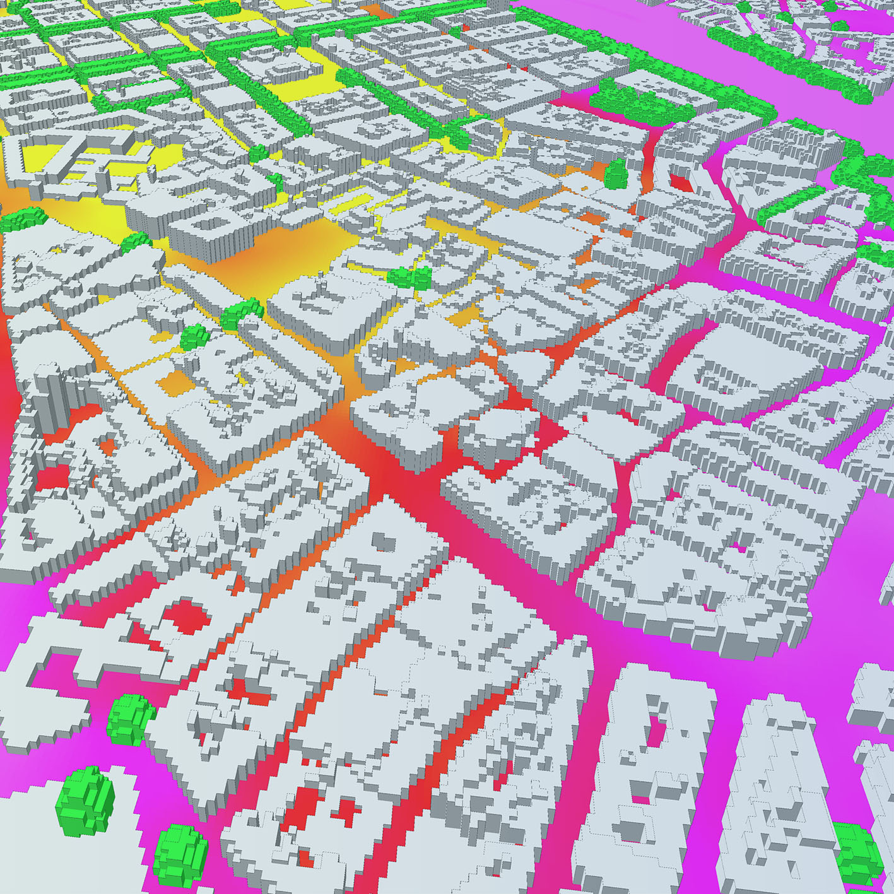
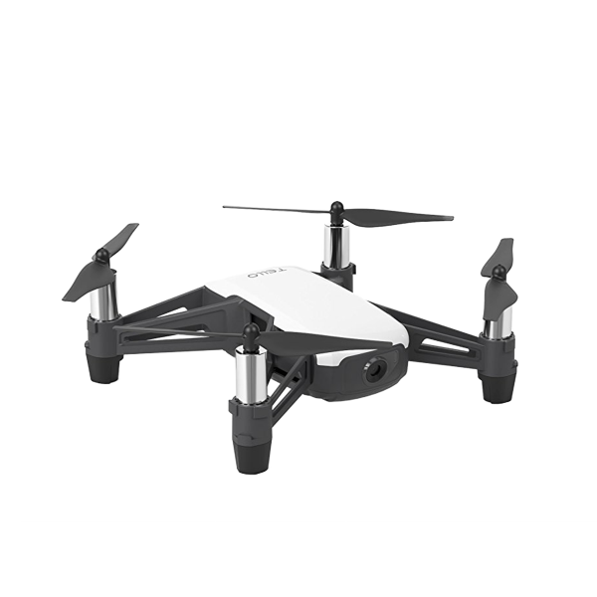
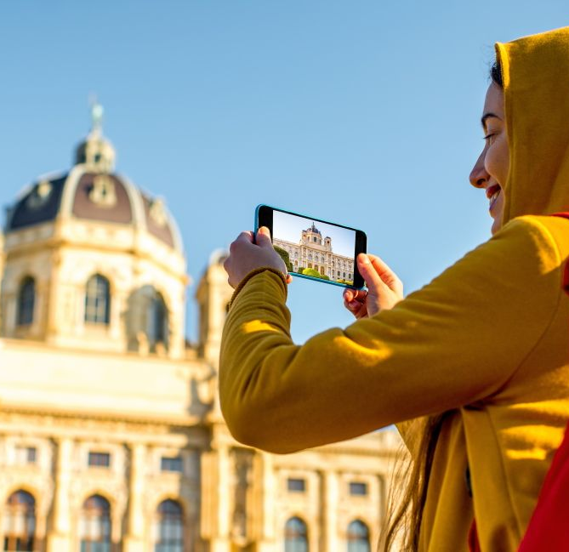
The HYPERION solution

Slide 9
The HYPERION solution
HYPERION is expected to use existing tools and innovative technologies to deliver an integrated resilience assessment platform.
Through use of the HYPERION platform, end users will be able to have a better understanding of the dangers and threats to tangible cultural heritage, make decisions for a swifter and more effective response, and contribute to the sustainable reorganization of the historical regions under threat.

Slide 10
HYPERION main components
Technologies
Advanced Machine Learning
Participative Cultural Heritage
Services
Copernicus Climate Change (C3S)
Euro-CORDEX
Galileo
Copernicus Emergency Management (CEMS)
Tools
Terrestrial Imaging
Satellite Imaging
Wide Area Inspection
Climate/Extreme Events models
Decay Models of materials

Slide 11
Impact
Multi-hazard risk understanding
Better preparedness
Faster, adapted, efficient response
Sustainable reconstruction
Quantitative impact assessment

Slide 12
HYPERION End Users
Professionals responsible for the management and preservation of local tangible cultural heritage assets – such as policy makers, public authorities, municipalities, ephorates of antiquities, cultural institutions, etc.
Professionals with a key role in conservation-restoration & in safeguarding cultural heritage – such as researchers, archaeologists, conservators, historians, etc.

Slide 13
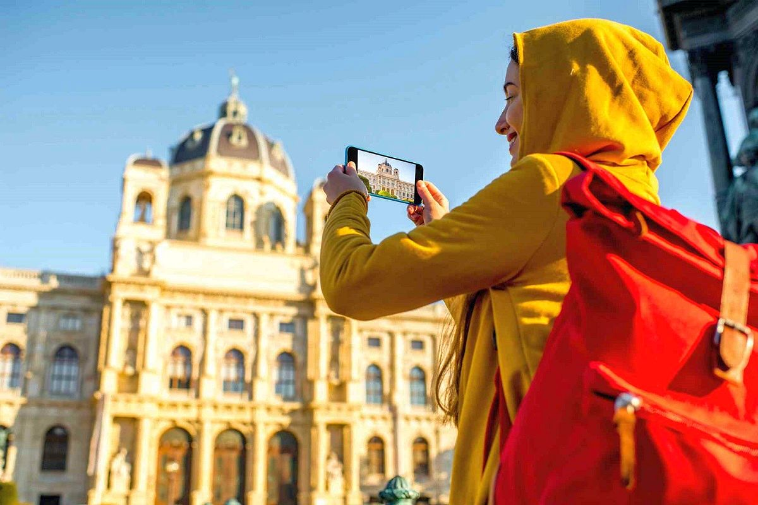
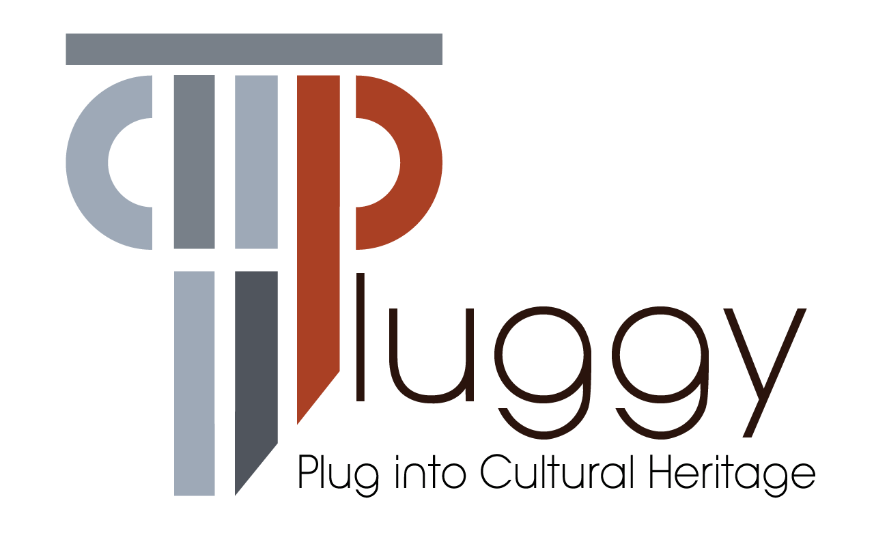
What makes HYPERION unique
HYPERION will engage local communities and the citizens, mobilising them to identify potential hazards and raise awareness of issues relating to the preservation of regional and European cultural heritage.
How: through special & dedicated use of PLUGGY, the Pluggable Social Platform for Heritage Awareness and Participation (https://www.pluggy-project.eu/).

Slide 14
TEST SITES

Slide 15
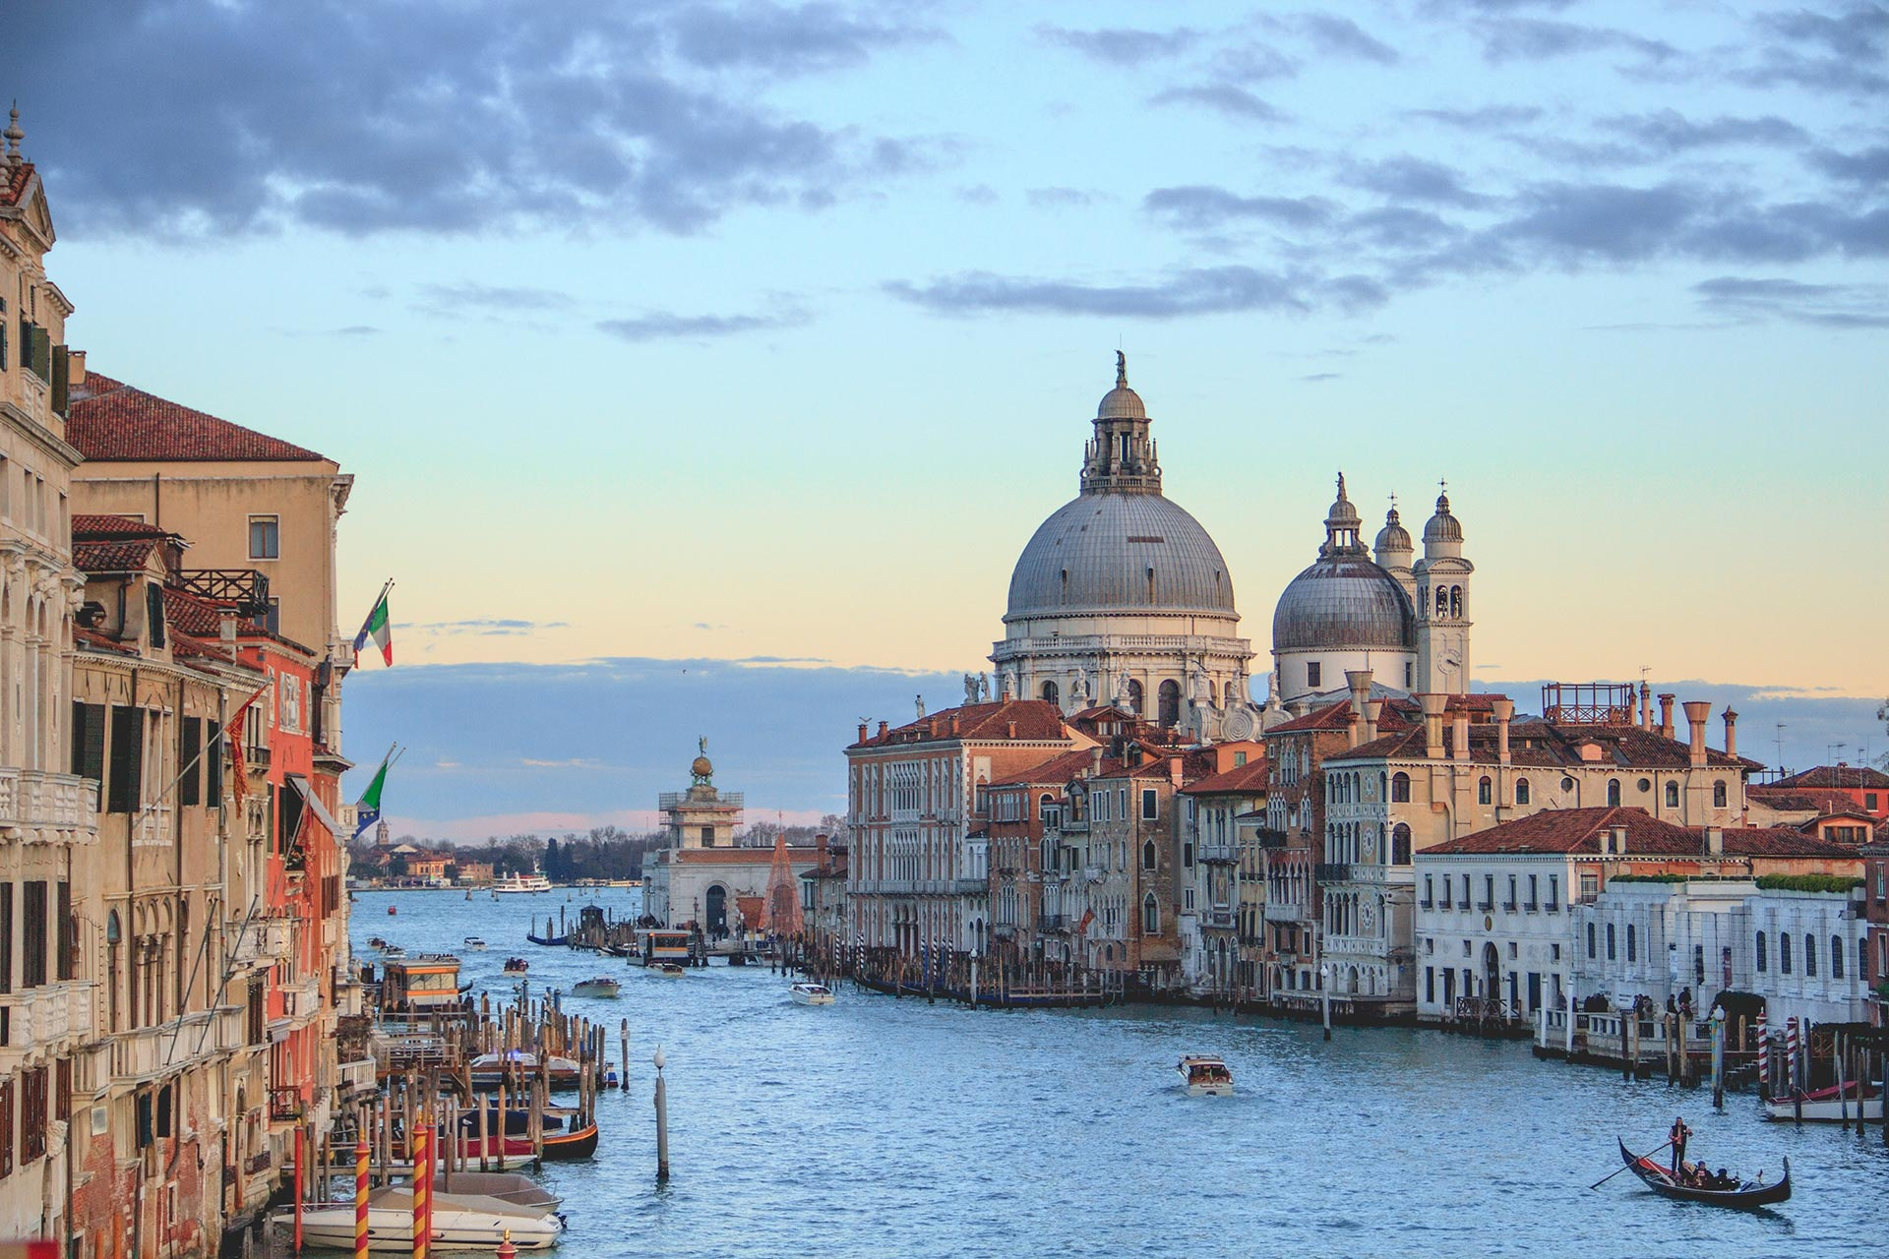
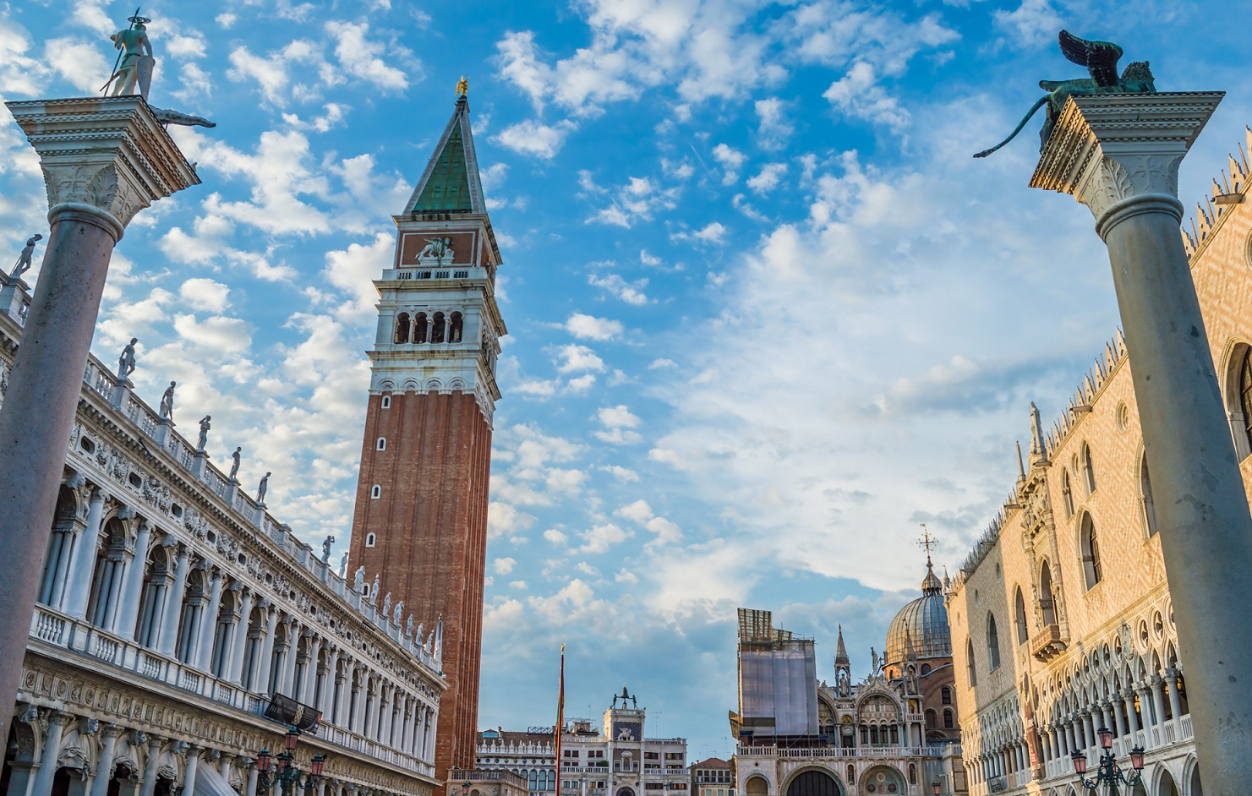
Four flagship test sites (1/4)
Venice, Italy

Slide 16
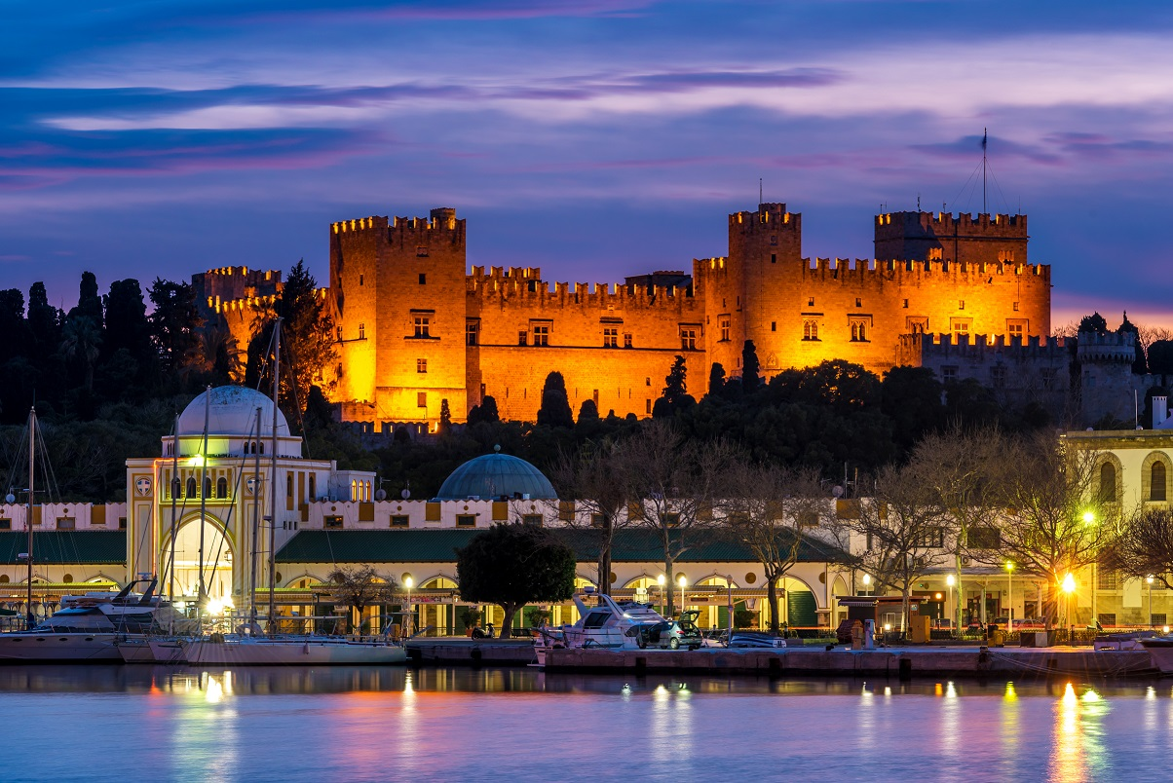
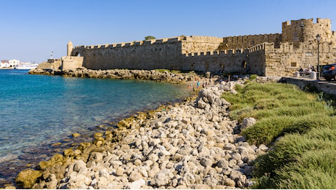
Four flagship test sites (2/4)
Medieval city of Rhodes, Greece

Slide 17
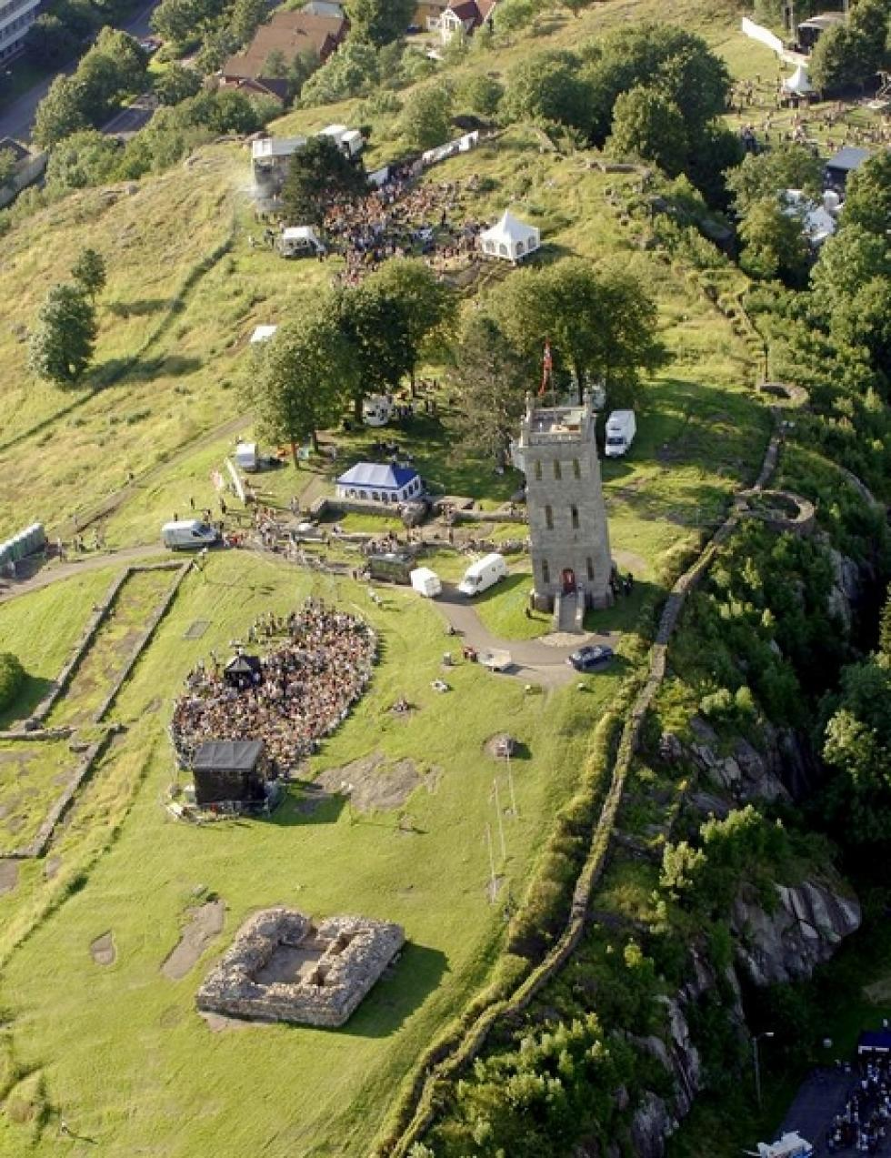
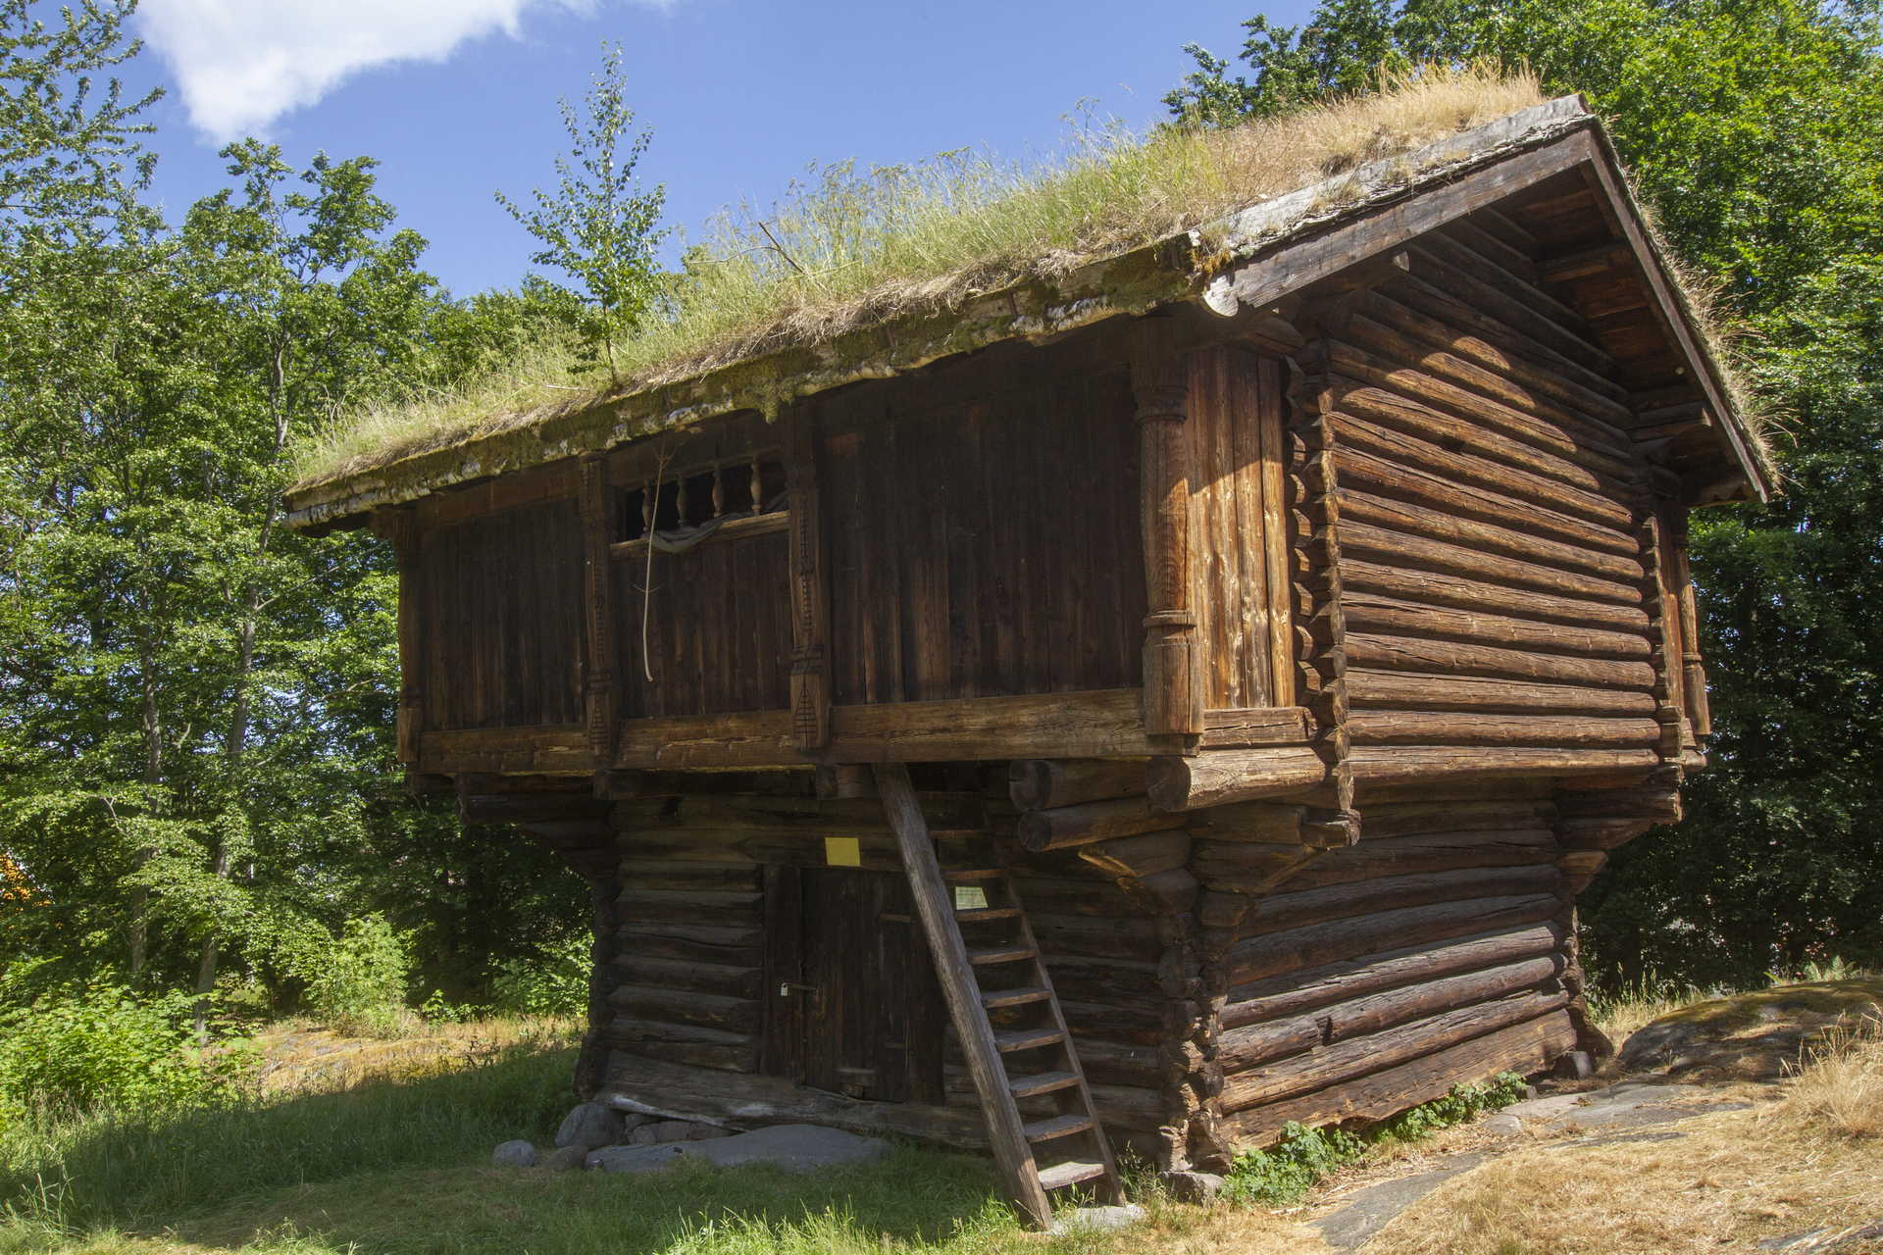
Four flagship test sites (3/4)
City of Tønsberg, Norway

Slide 18
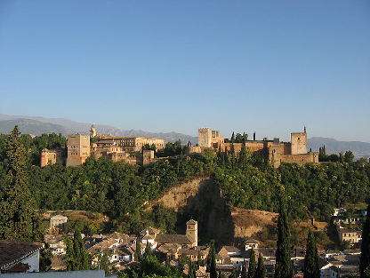
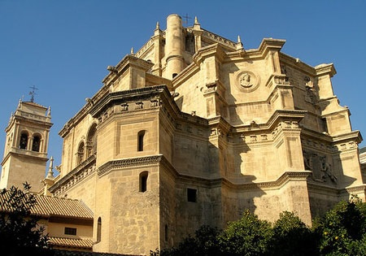
Four flagship test sites (4/4)
Granada, Spain

Slide 19
MEET the PARTNERS

Slide 20
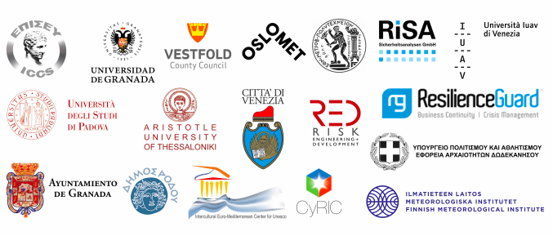
HYPERION team (1/2)

Slide 21
HYPERION team (2/2)
18 partners from 8 EU countries;
Greece, Italy, Spain, Norway, Cyprus, Germany, Switzerland, Finland;
interdisciplinary background;
universities, research institutes, companies;
end-users (cultural institutions & municipal authorities).
Partners from Greece:
Institute of Communication & Computer Systems
Municipality of Rhodes, Intercultural Euro-Mediterranean Center for Unesco
National Technical University of Athens
Aristotle University of Thessaloniki
Dodecanese Ephorate of Antiquities

Slide 22
Discover more about HYPERION

Slide 23
Through…
Project’s Coordinator: Dr Angelos Amditis, Institute of Communication and Computer Systems (ICCS), a.amditis@iccs.gr
Our partners in Greece, Italy, Spain, Cyprus, Norway, Finland, Switzerland, Germany
Our Website: www.hyperion-project.eu
Subscribe to our Newsletters & Magazines
Our Social Networks:
@HyperionEUProject
@EuHyperion
@HyperionEUProject

Slide 24
Thank you all!
Name, Organisation: | Contact details

