Slide 1
Norwegian Pilot Area
City of Tønsberg and the «Slottsfjellet» area
Mahdi Kioumarsi & Amirhosein Shabani

Slide 2
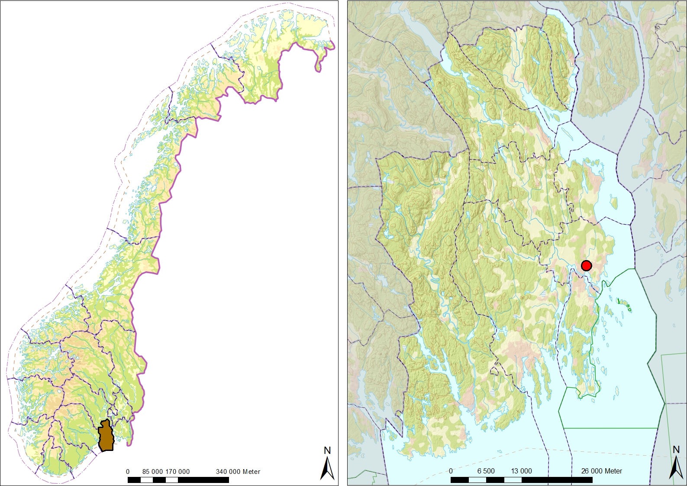
Vestfold County and the City of Tønsberg
TØNSBERG
OSLO

Slide 3
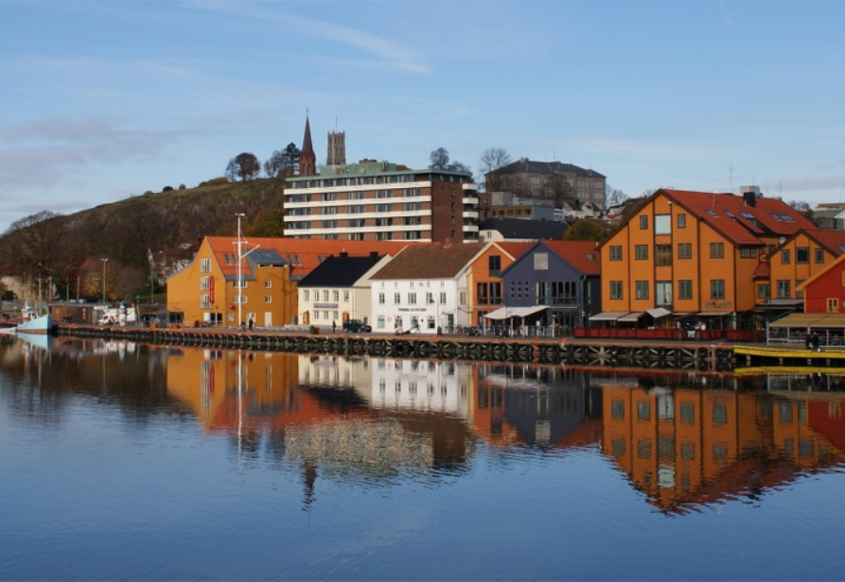
The City of Tønsberg
Founded: During the Viking period – 10th Century
Inhabitants: 45 000
The Capital and Administrative Centre of Vestfold County

Slide 4
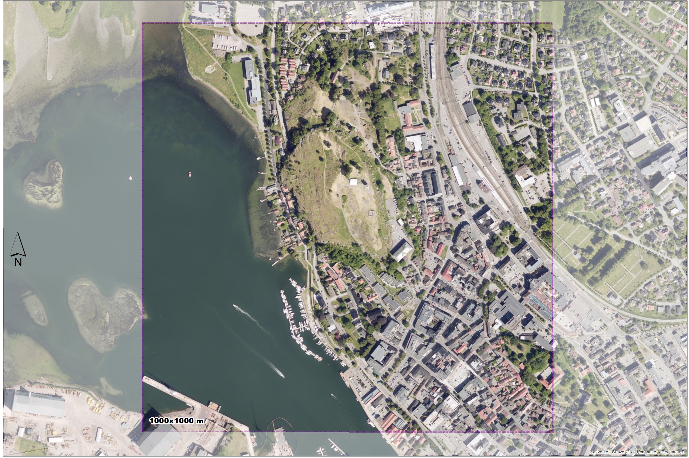
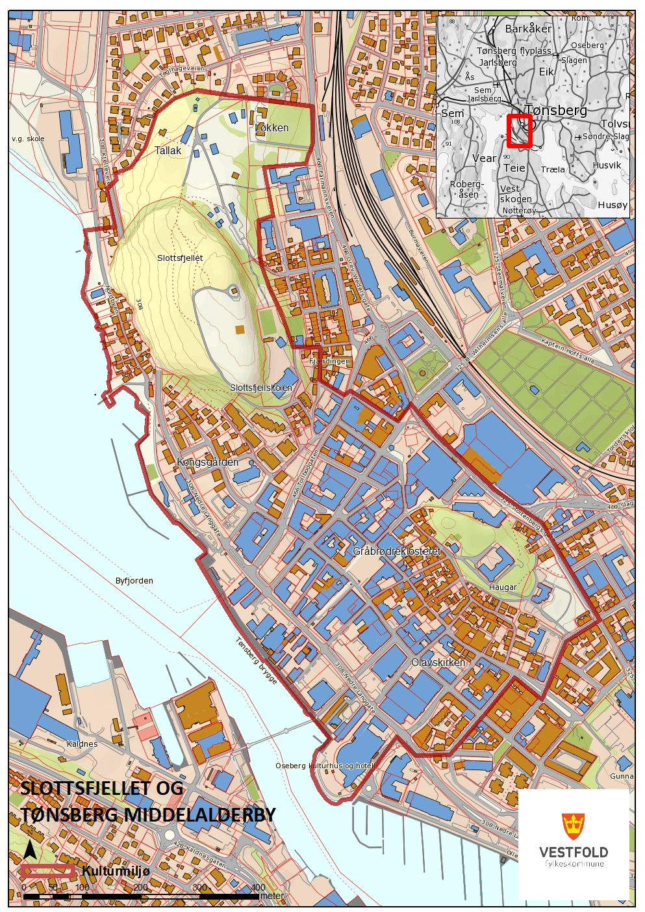

Slide 5
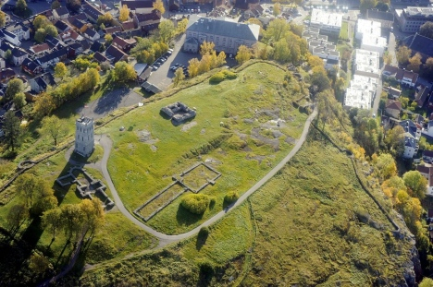
Castrum Tunsbergis –
13th Century
Situated on a cliff with steep sides
Totally destroyed in 1507

Slide 6
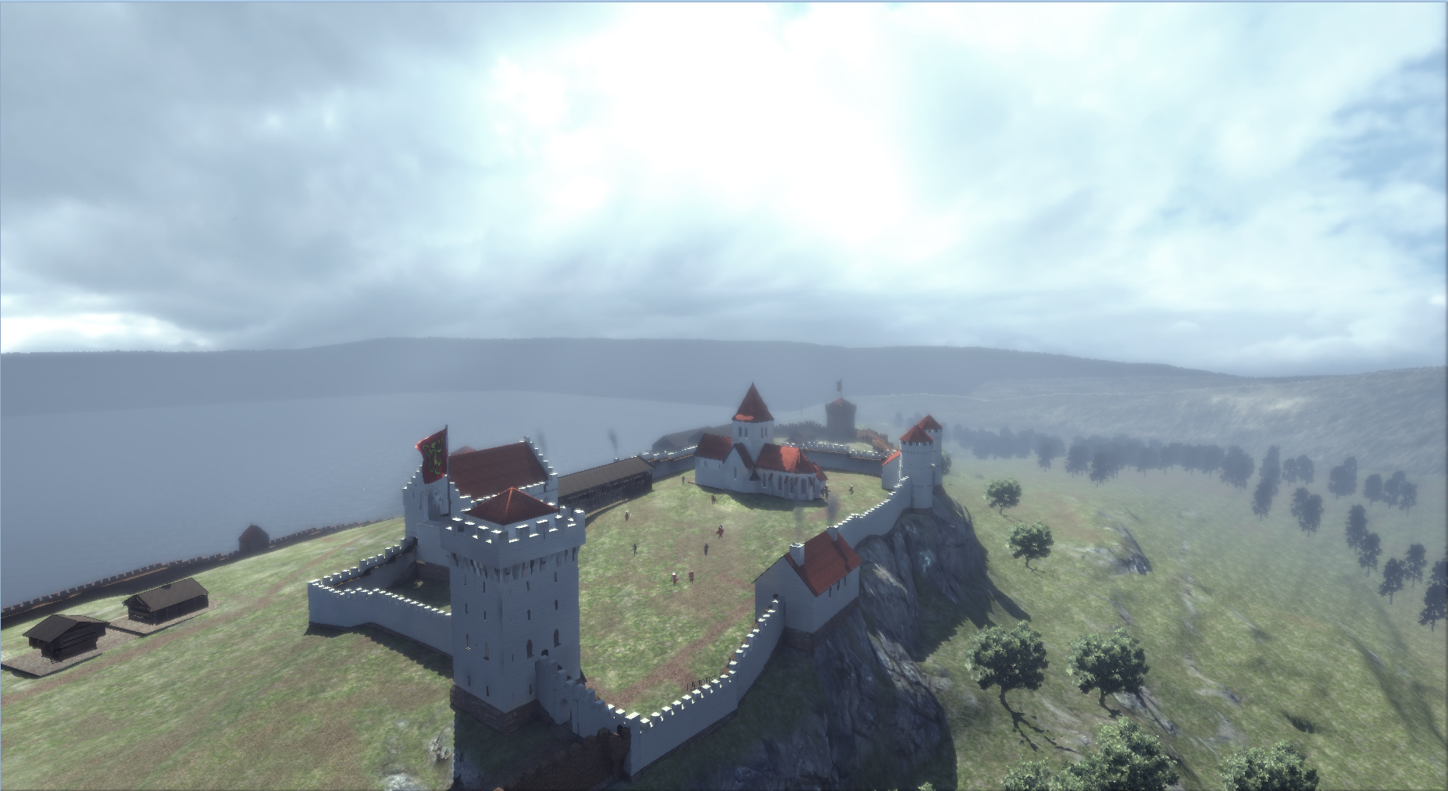

Slide 7
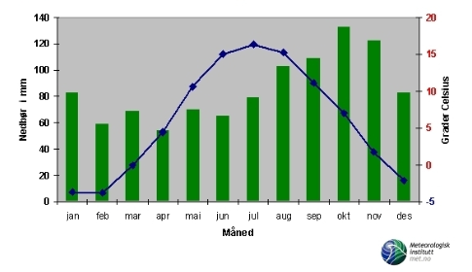
Average (normal) Temperature and Rainfall, Tønsberg (1961-90)
Most relevant Factors:
Heavy winds
Heavy rain fall
Freeze/thaw cycles
Humidity
Human activity

Slide 8
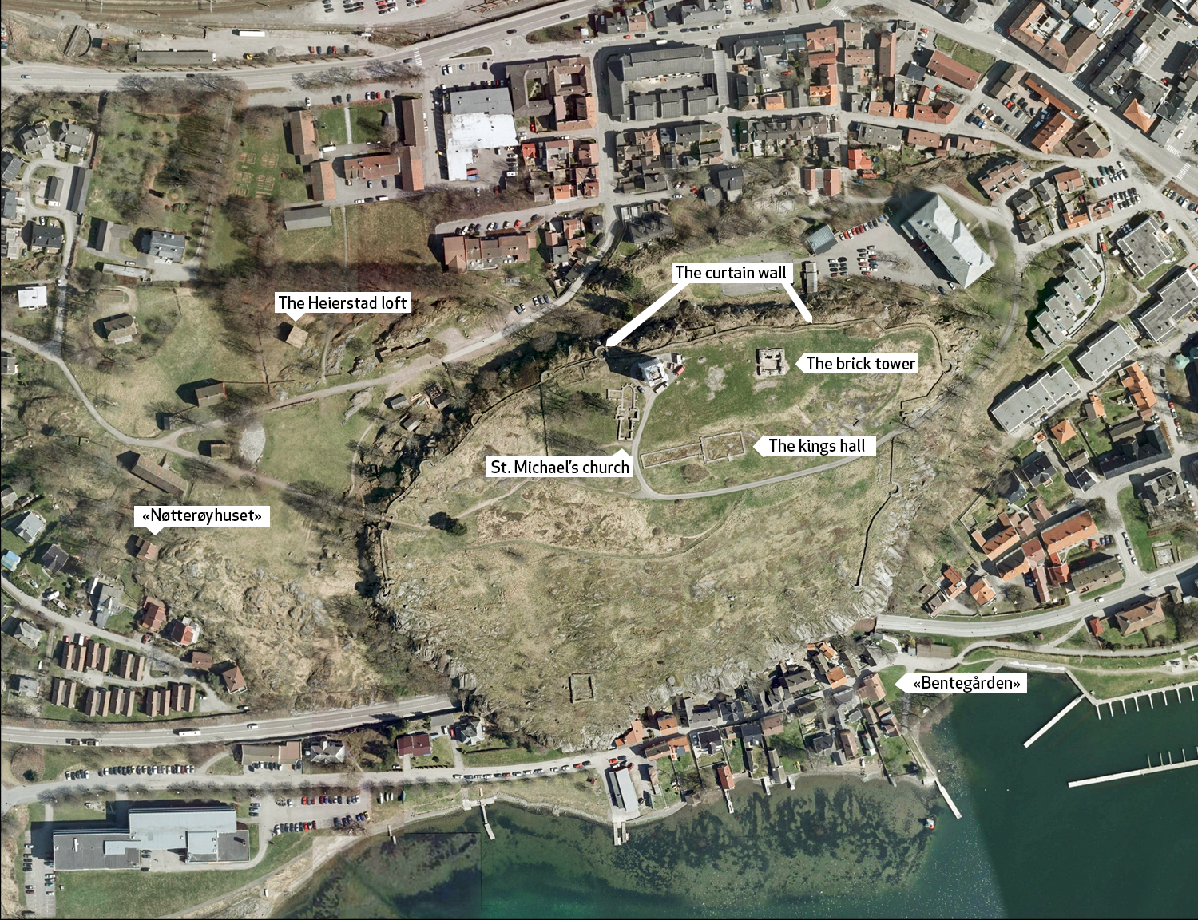

Slide 9
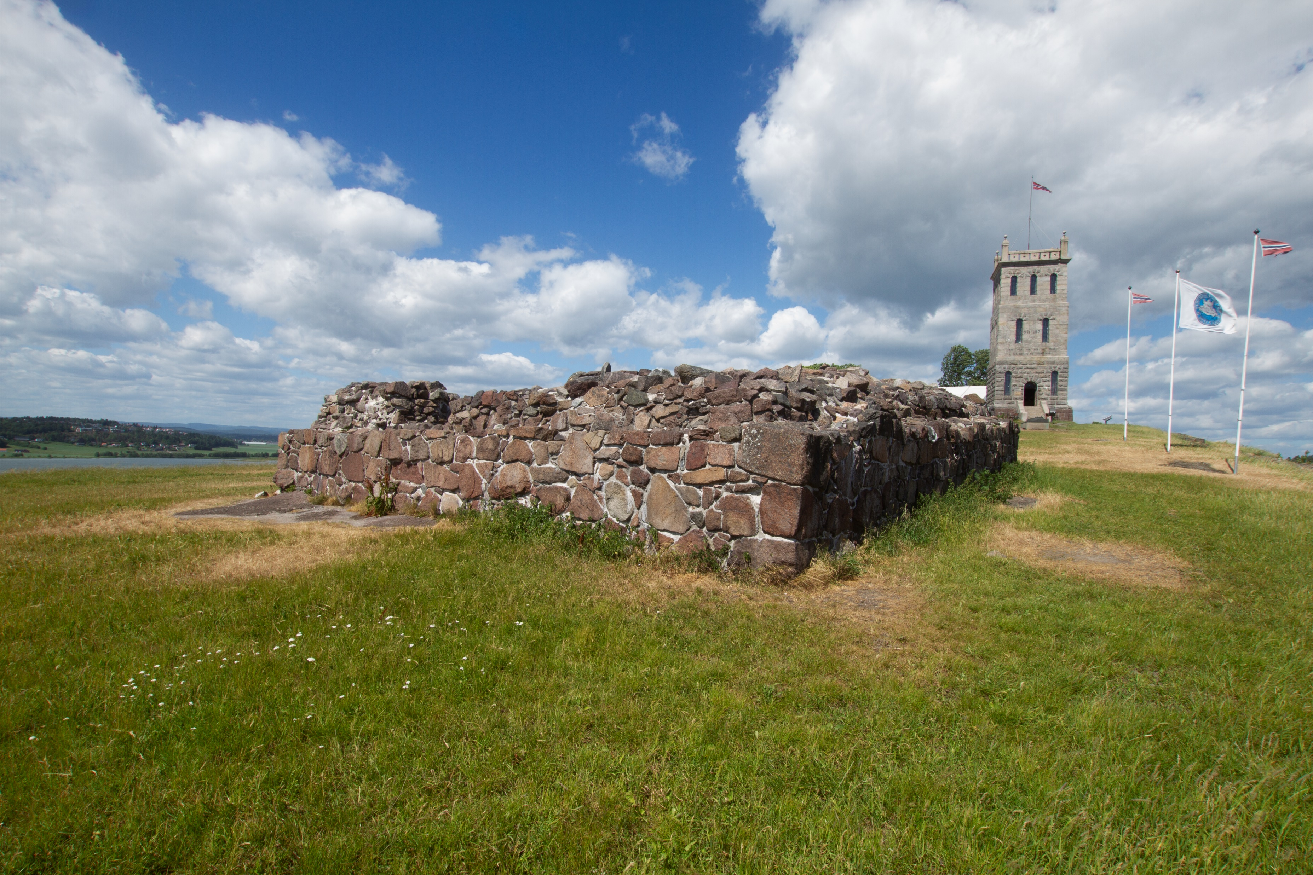
The Brick Tower (12th Century)
Materials involved:
Local stone (Granites and Porphyry)
Brick
Lime mortars

Slide 10
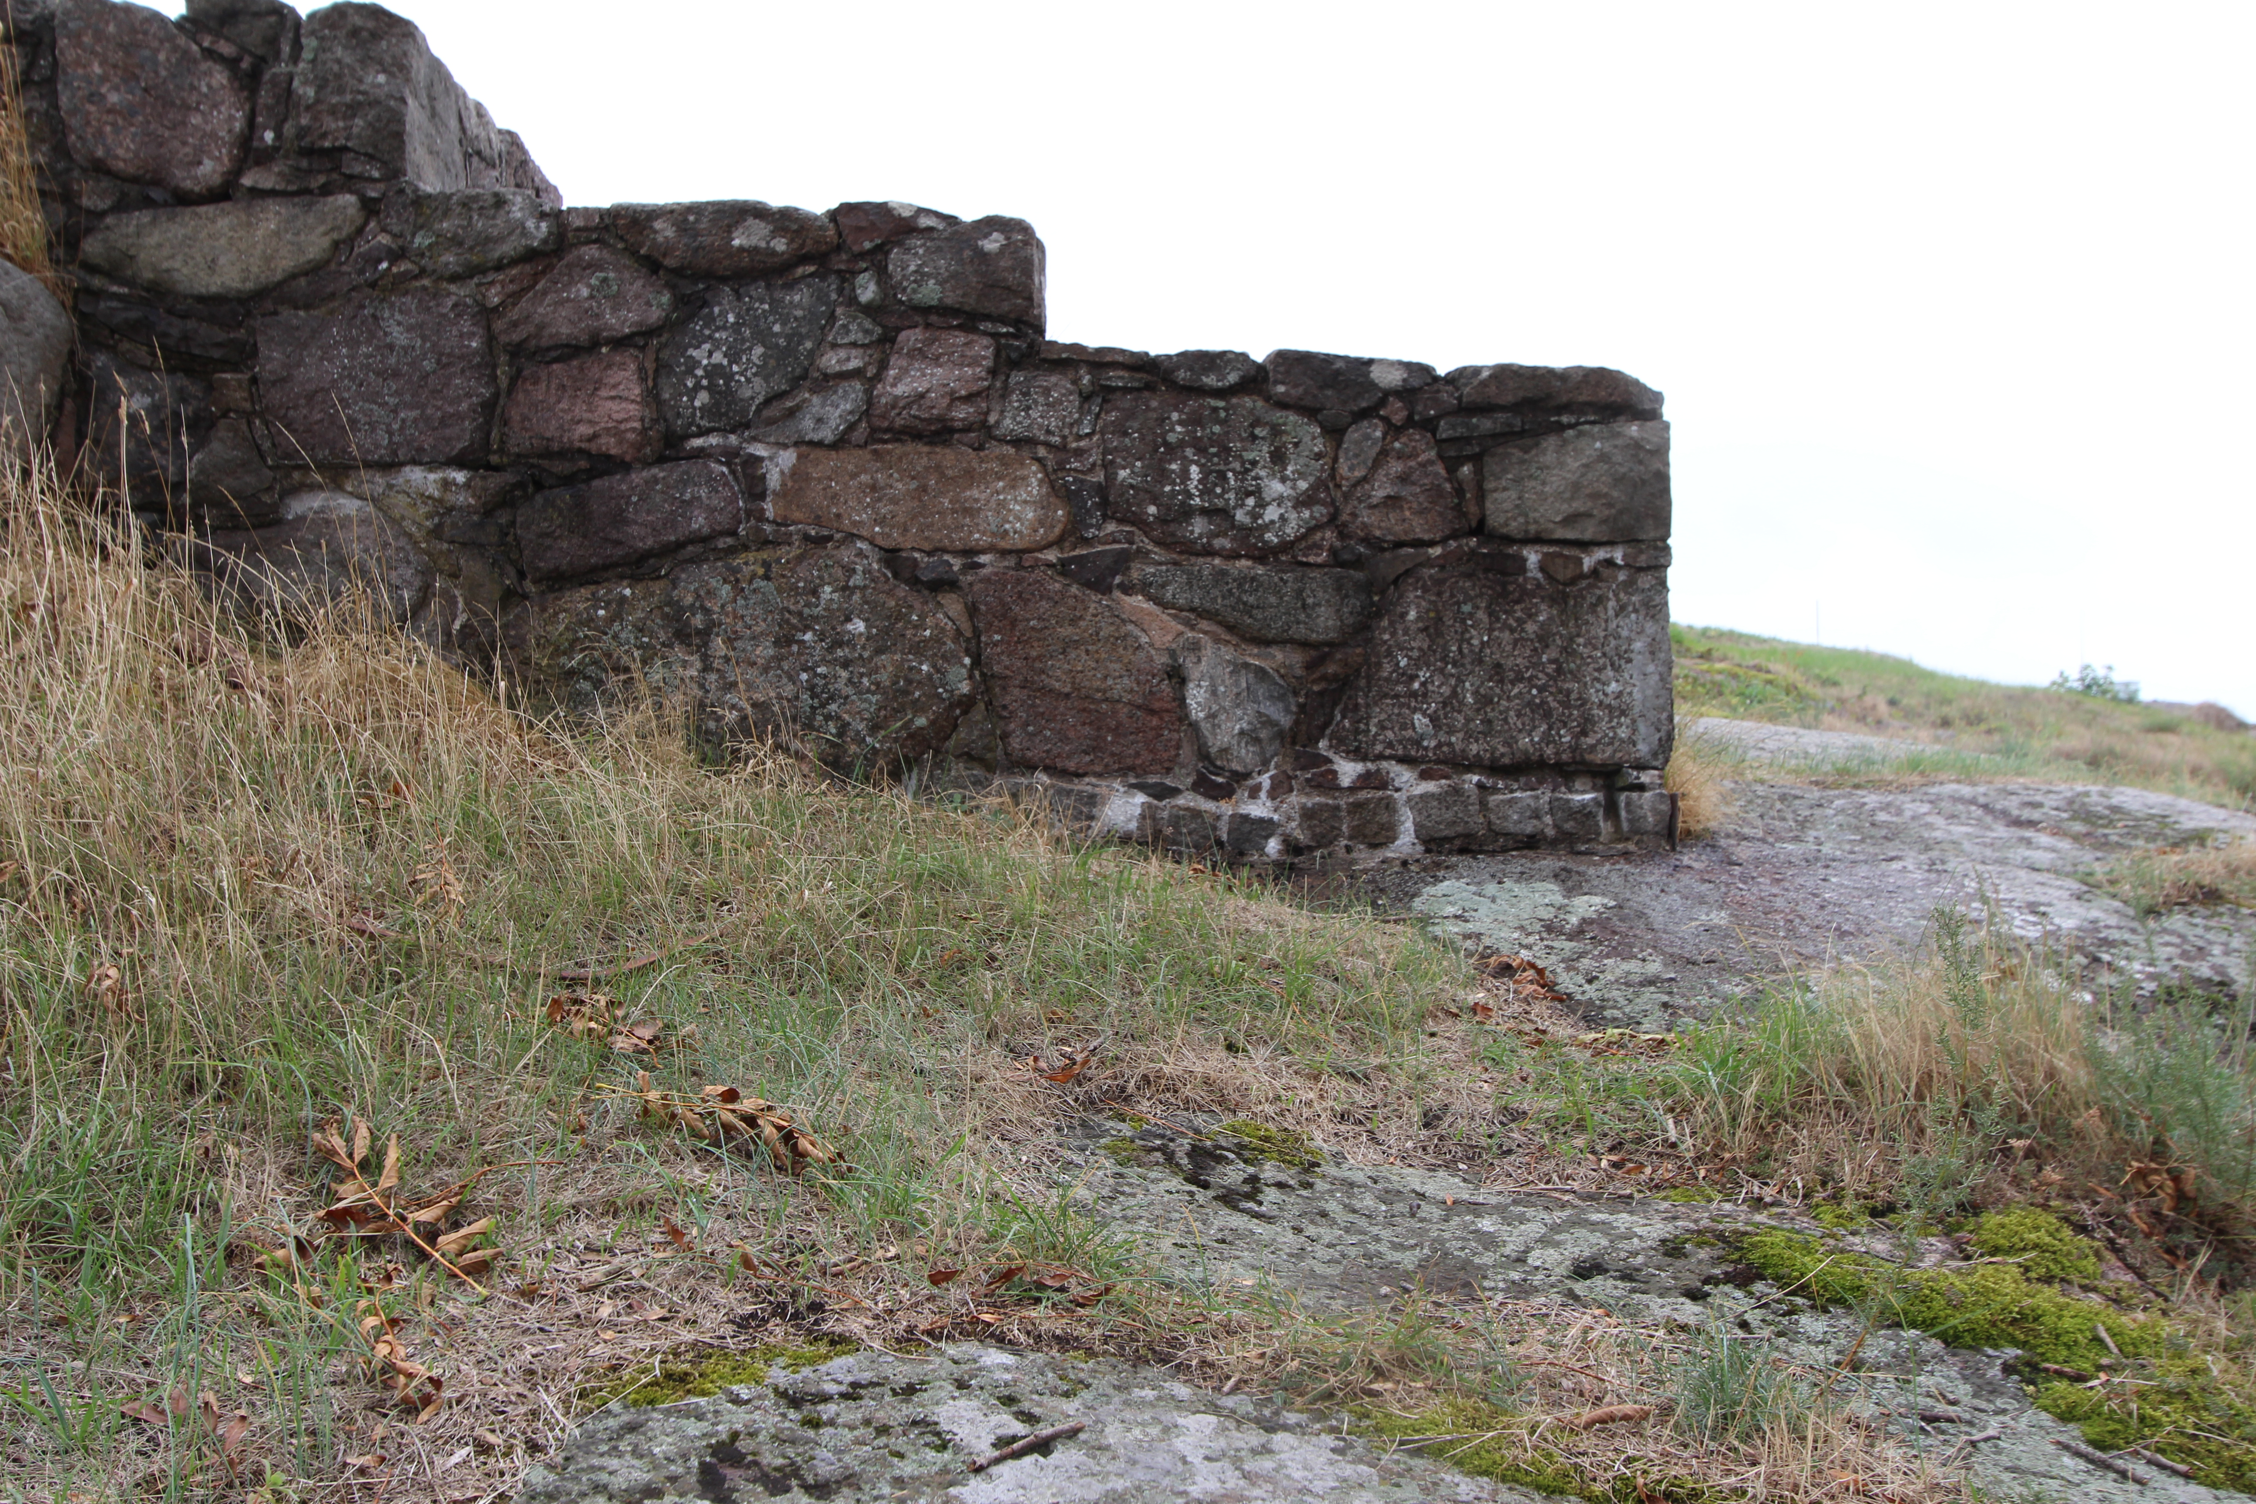
The Curtain Wall (12th Century)
Materials involved:
Local stone (Granites and Porphyry)
Brick
Lime mortars

Slide 11
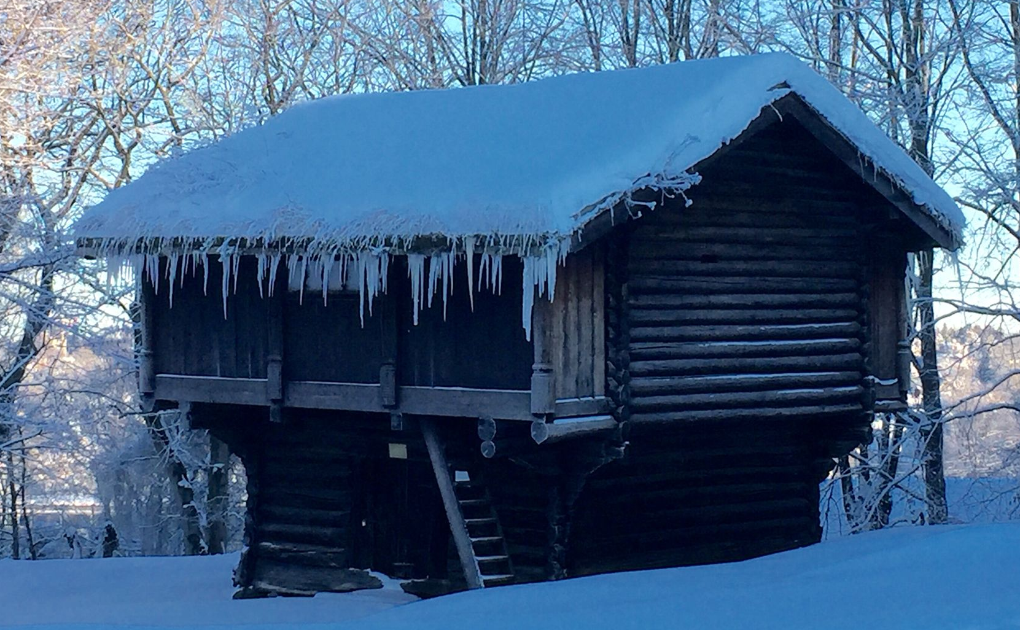
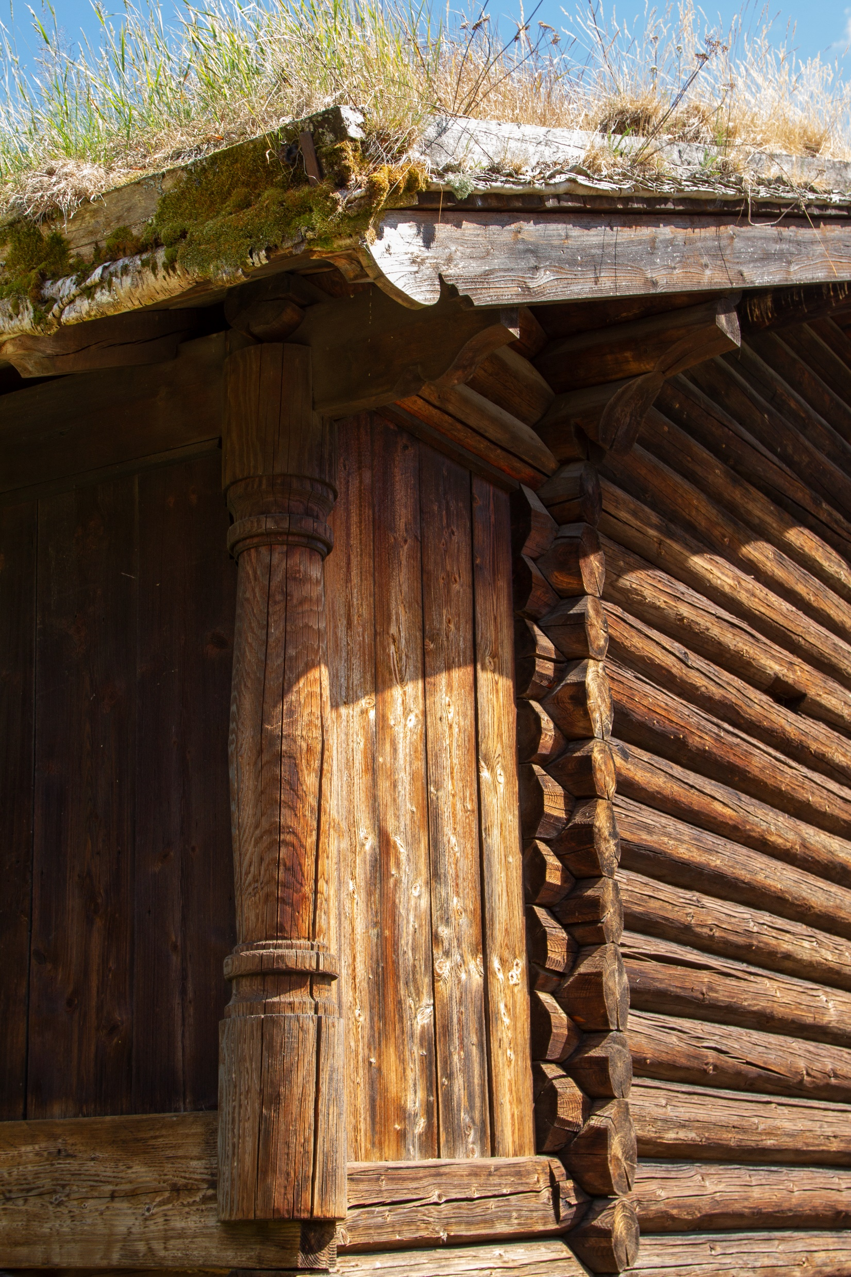
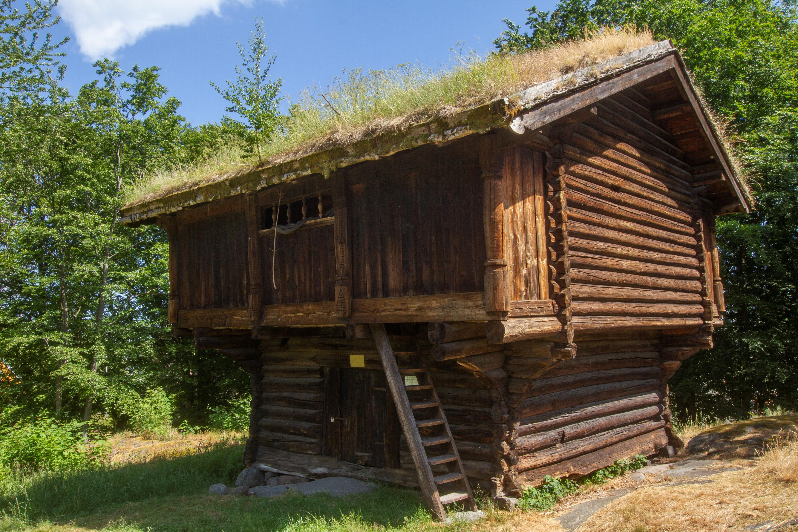
The Heierstad Loft
Dated 1407
The Heierstad Loft (1407)
Materials involved:
Logged timber/wood
(pine and spruce)
Birch bark (roofing)
Tar (surface treatment)

Slide 12
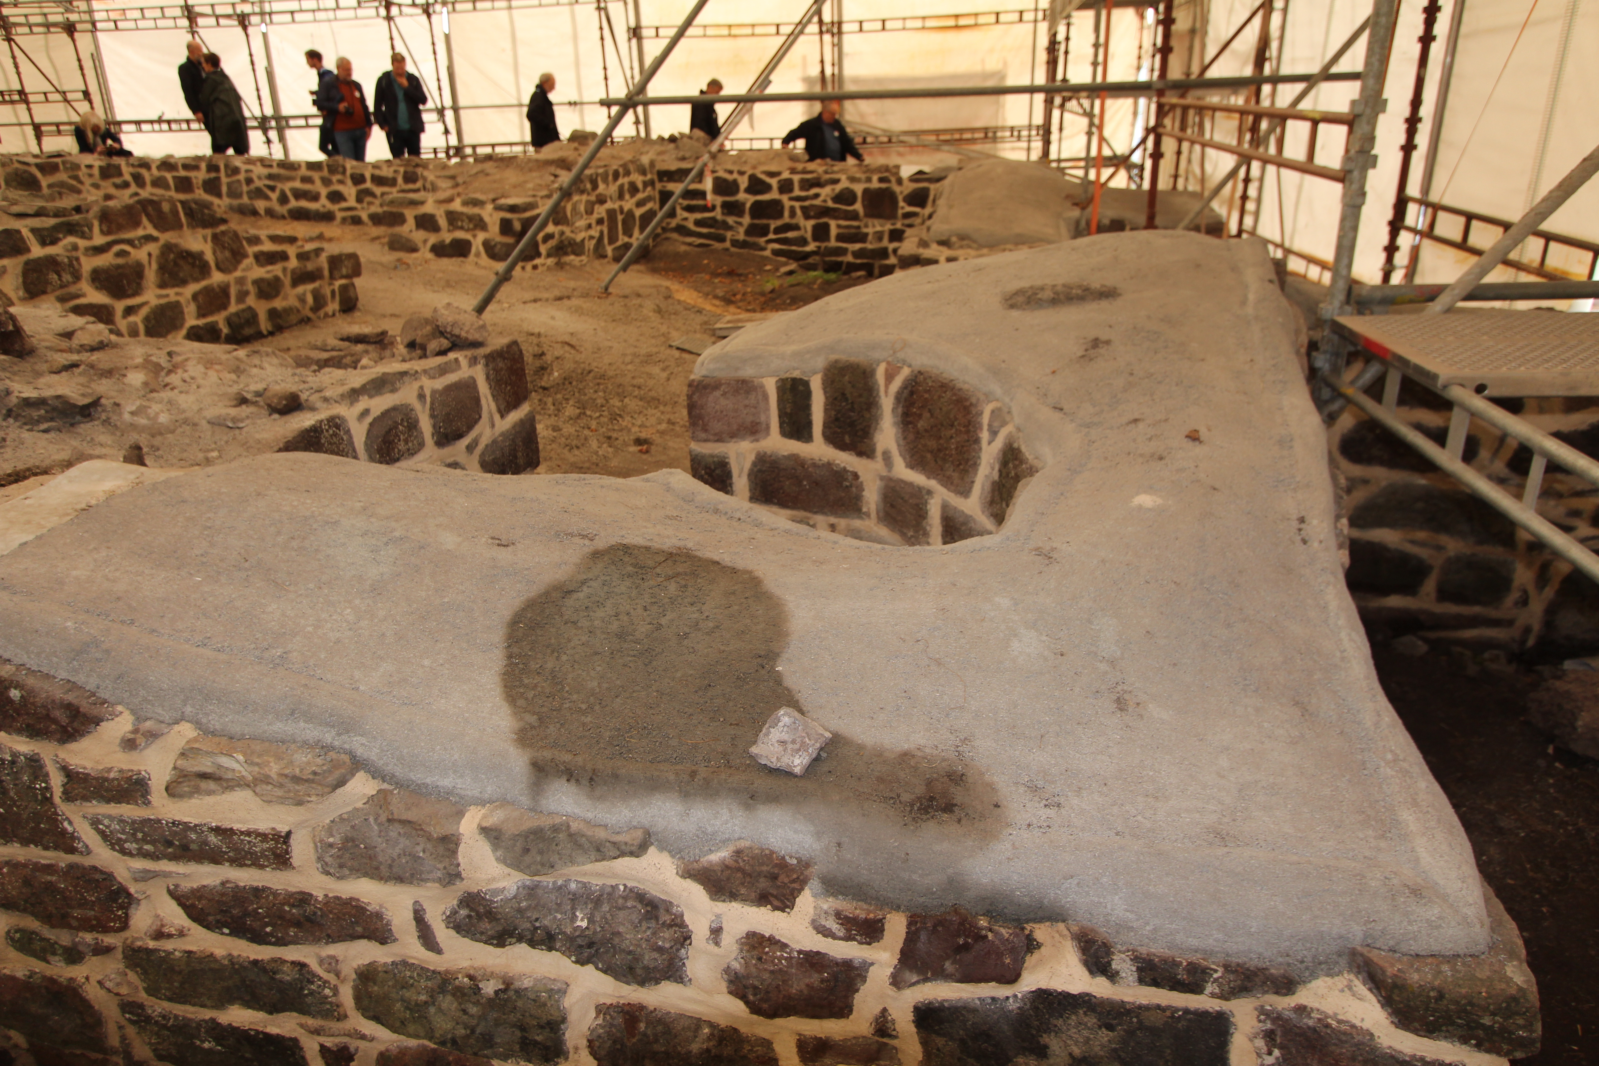
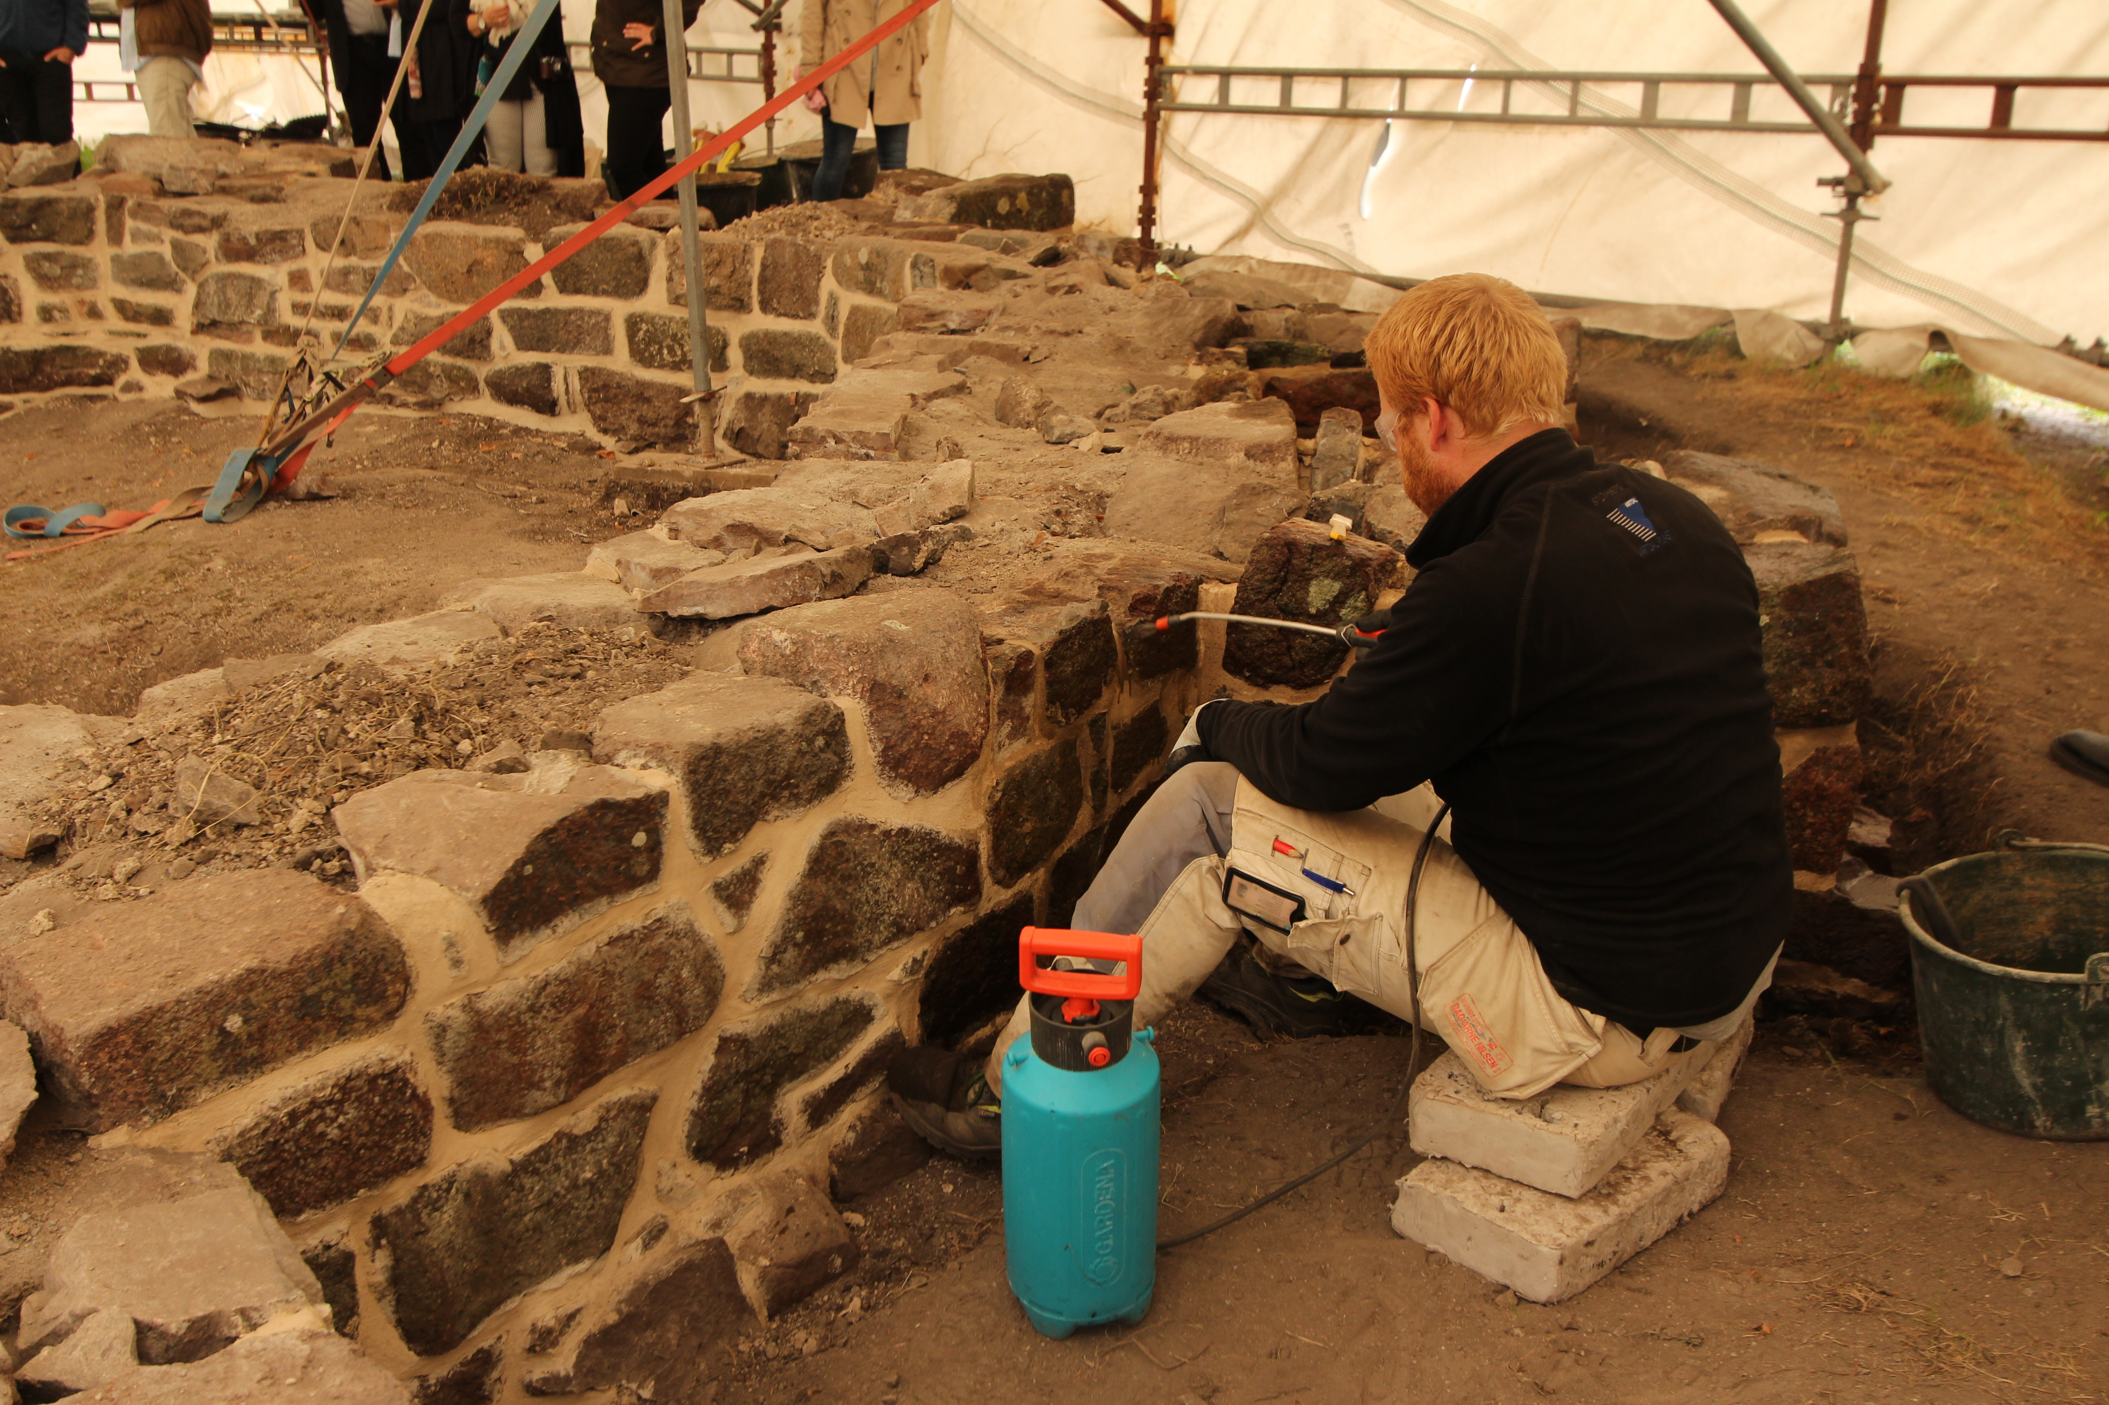
Conservation work 2018
St. Michael’s Church – “Slottsfjellet” ruins
Traditional vs Modern?

Slide 13
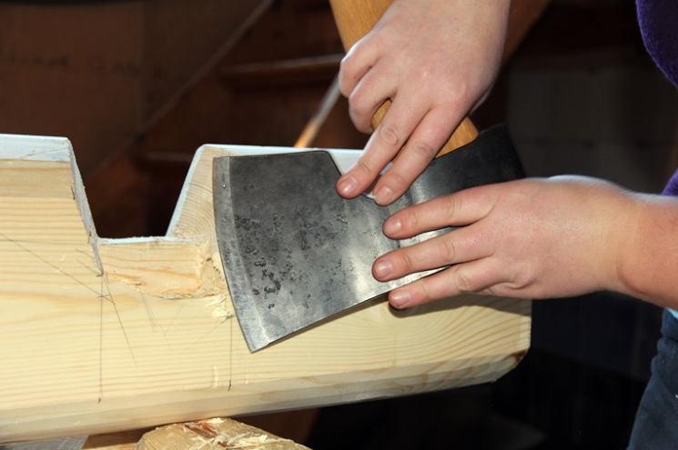
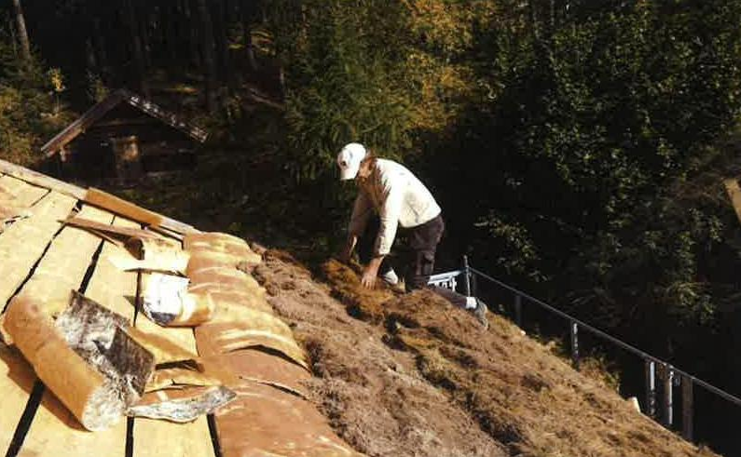
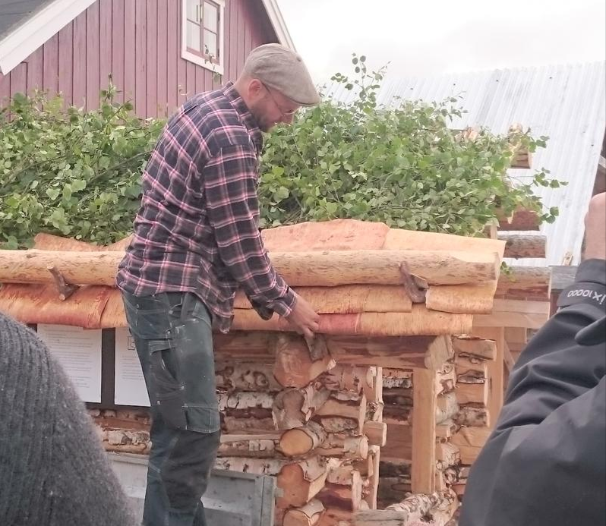

Slide 14
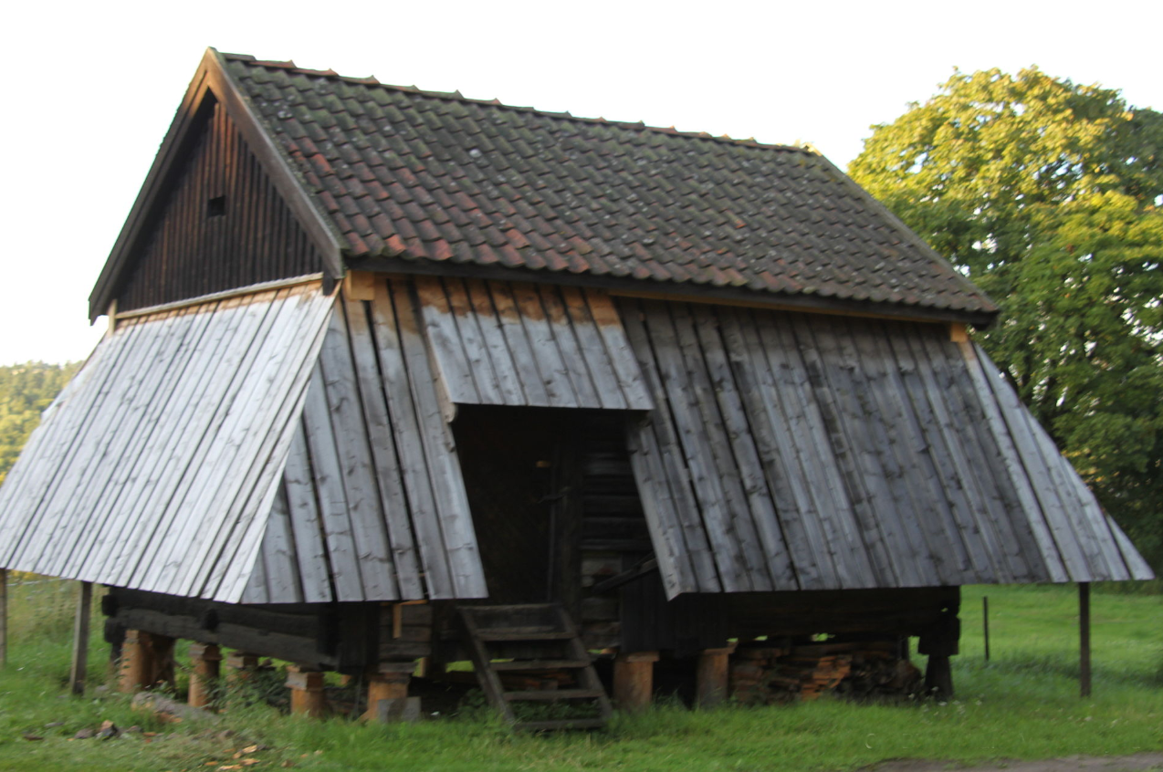
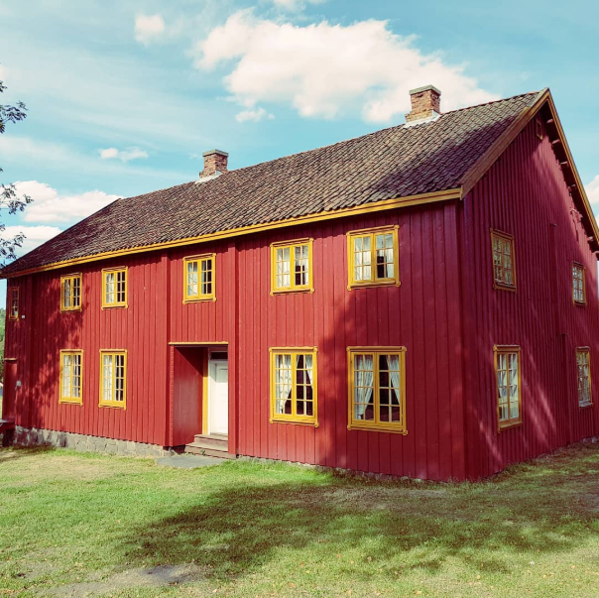
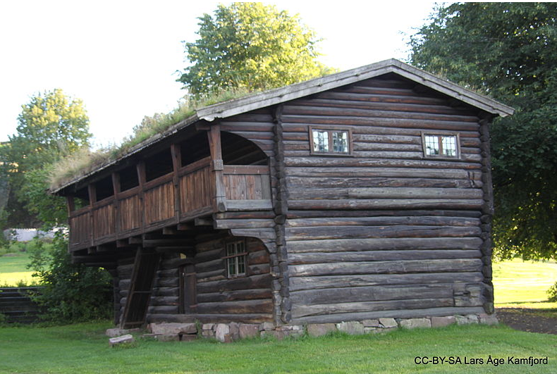
Listed and protected museum buildings
17- and 18th Century
Materials involved:
Logged timber
Wooden panel
Brick (roof tiles)
Surface treatment (Linseed oil paint, tar)

Slide 15
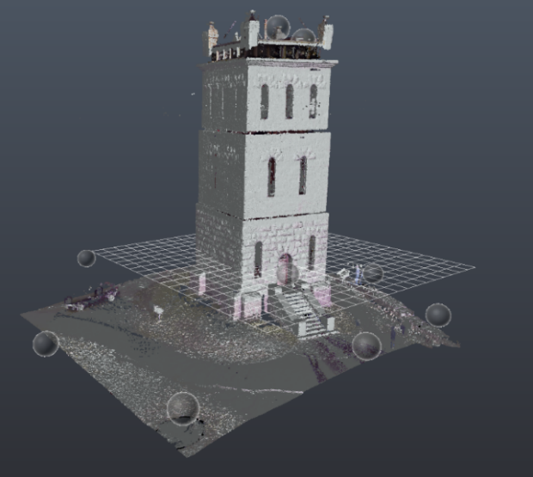
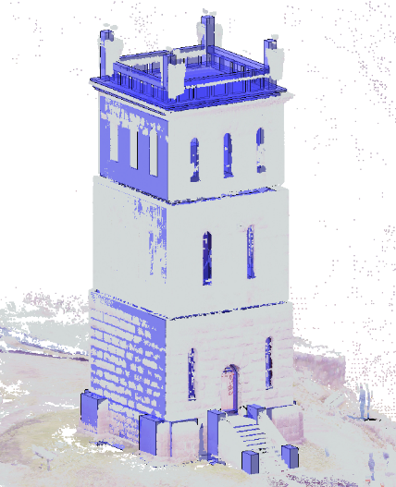
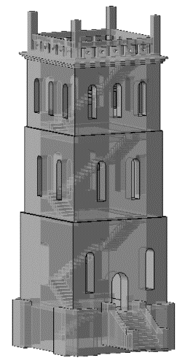
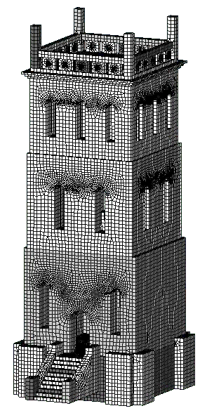
Finite element modeling of the Slottsfjel tower

Slide 16
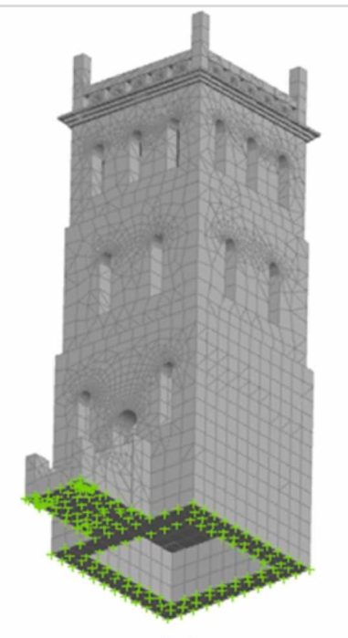
Soil structure interaction and model updating
Fixed-base model (FB)
Model with soil-structure interaction using Direct method (DM)
Accelerometers for test-setup
Model with springs using substructure method (SM)

Slide 17
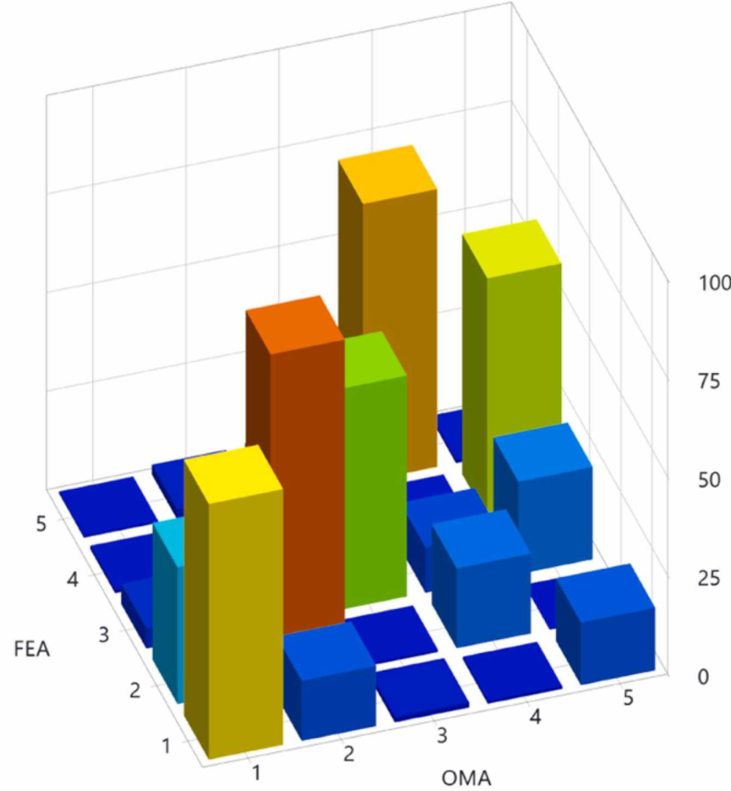
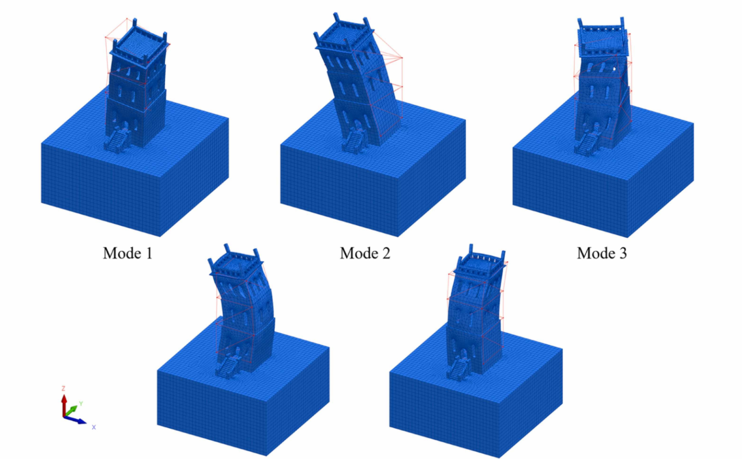
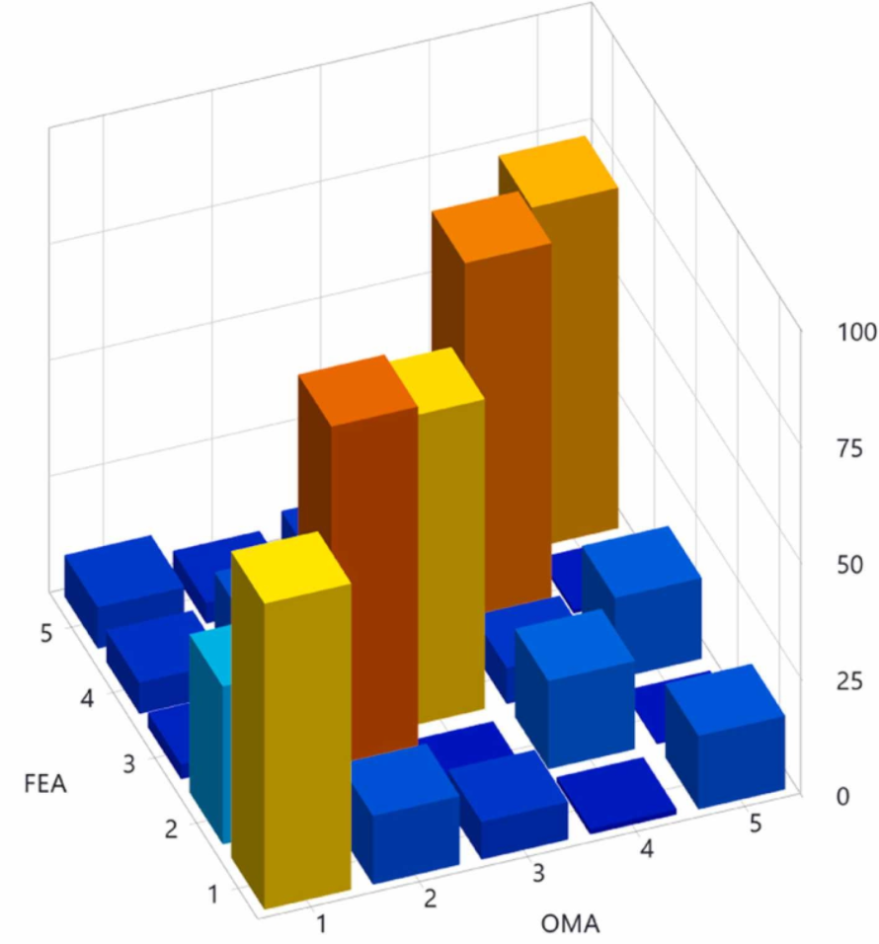
Model updating results
FB model
SM model
DM model
Mode 4
Mode 5

Slide 18
Linear dynamic analysis

Slide 19
Thank you for your Attention…

